Slide 1
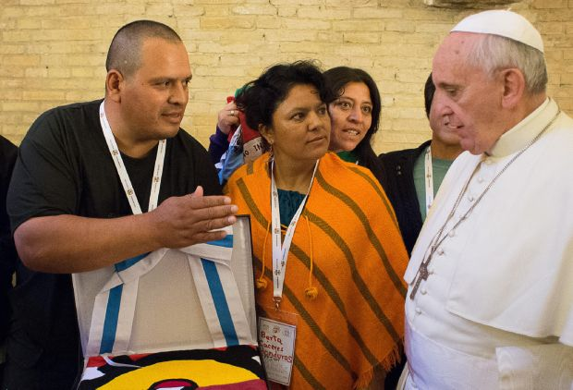
In Honor of the Life and Work of Indigenous Environmental and Human Rights Activist Berta Caceres who was assassinated in Honduras Thursday, March 3.

Slide 3

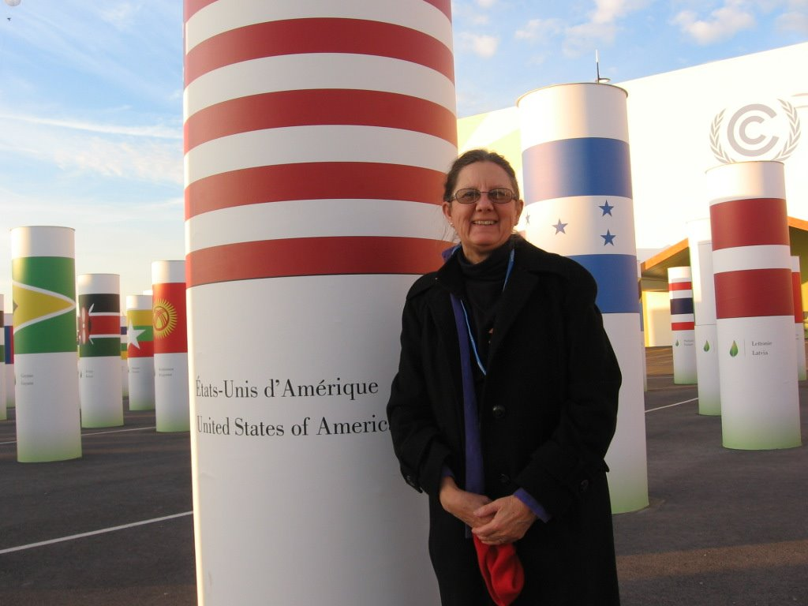
Love In Action
Caring for Our Common Home
UN Paris Climate Conference
General COP21 Presentation
Joan Brown,osf
www.nm-ipl.org-joan@nm-ipl.org

Slide 4
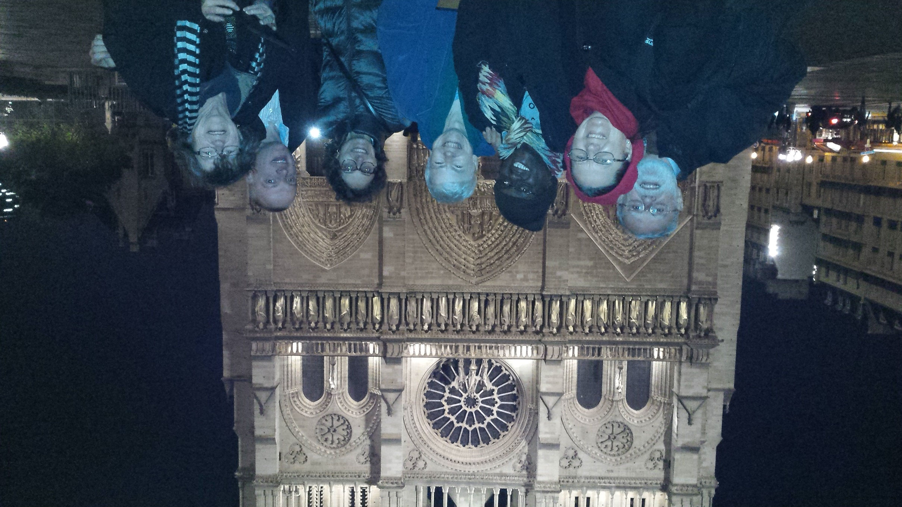

Slide 5
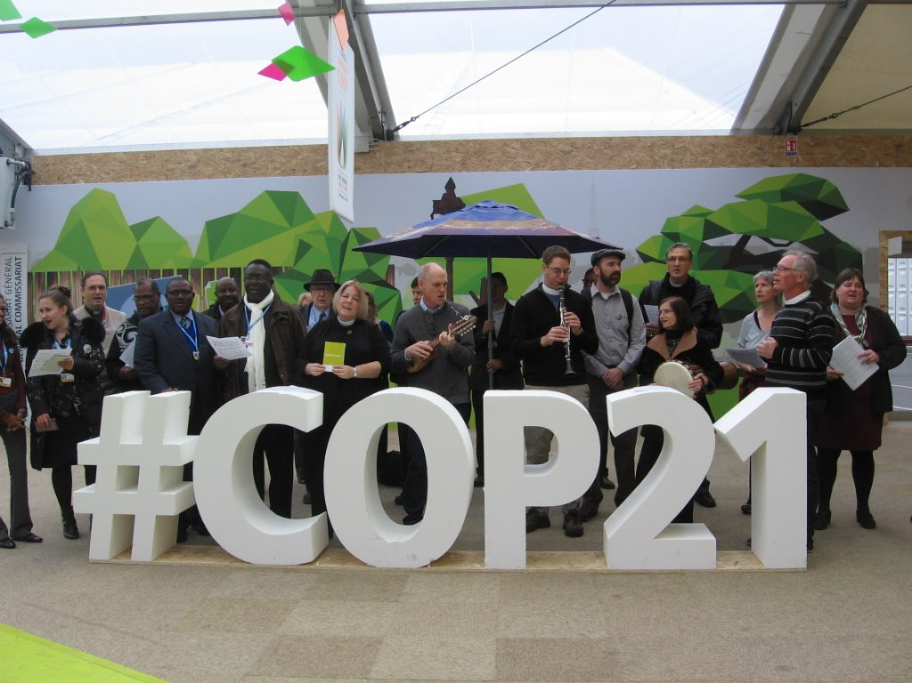

Slide 6
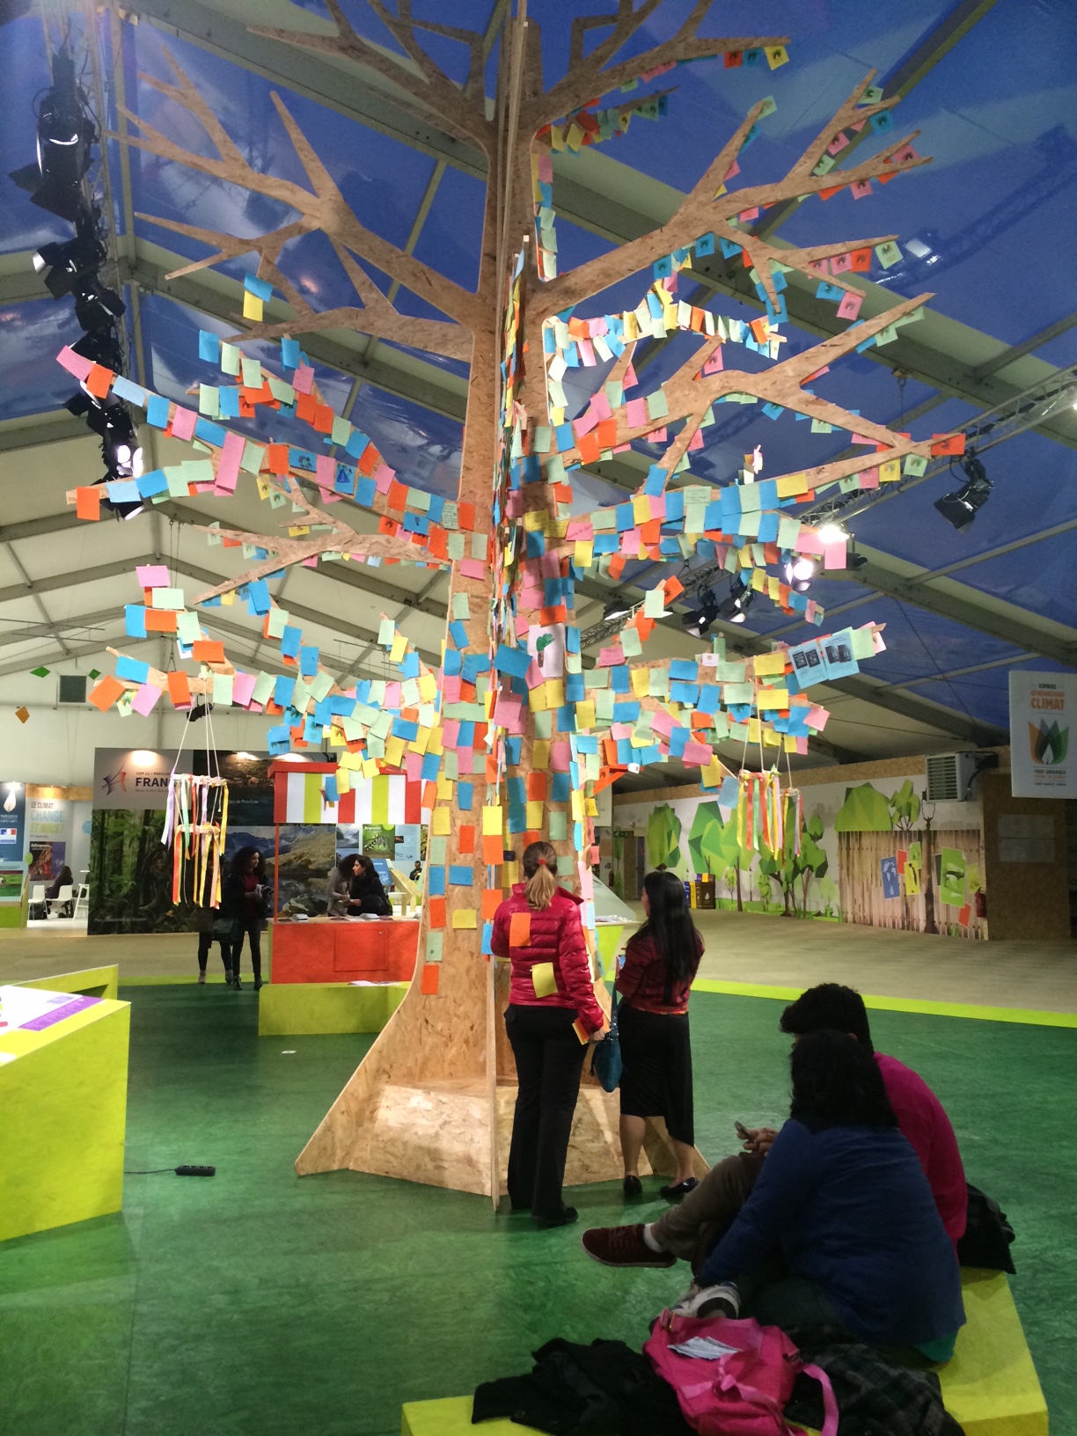

Slide 7
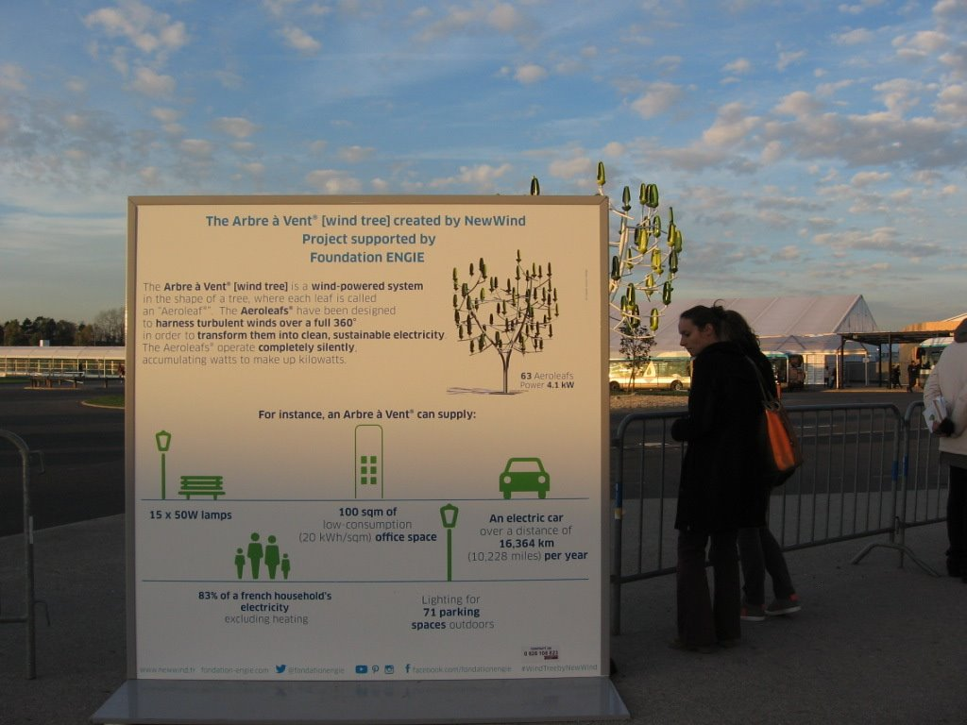

Slide 8
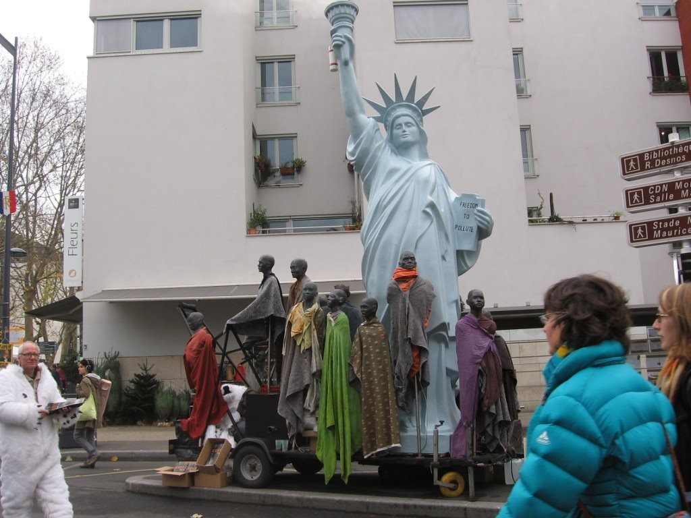

Slide 9
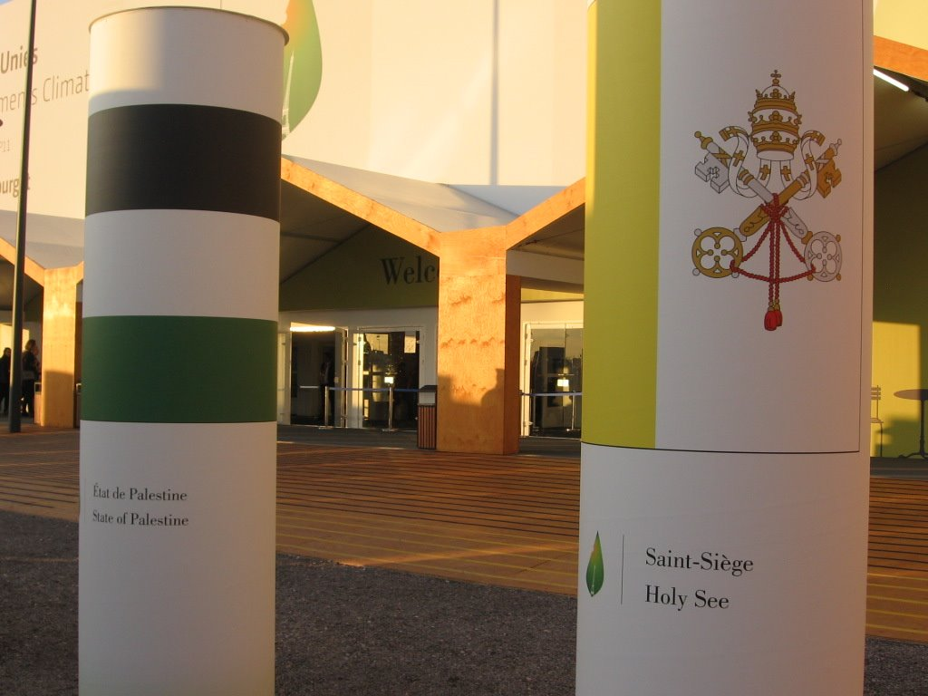
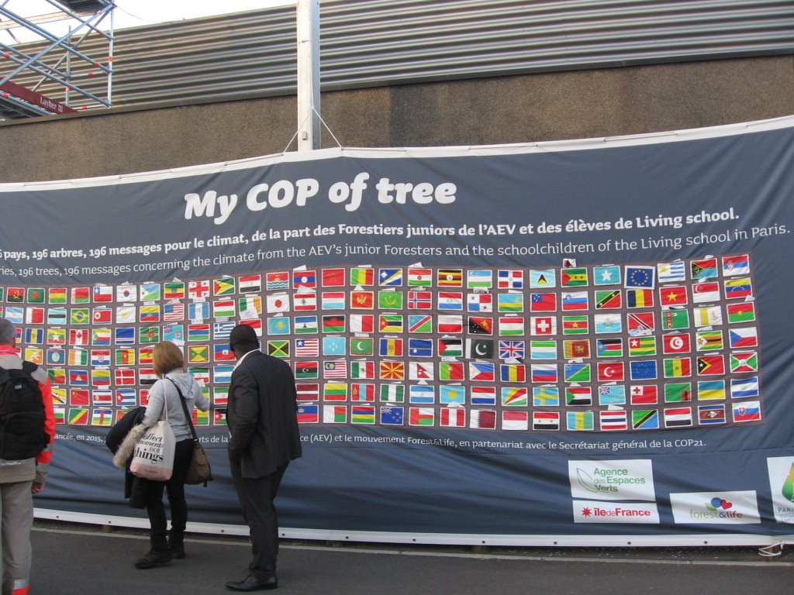
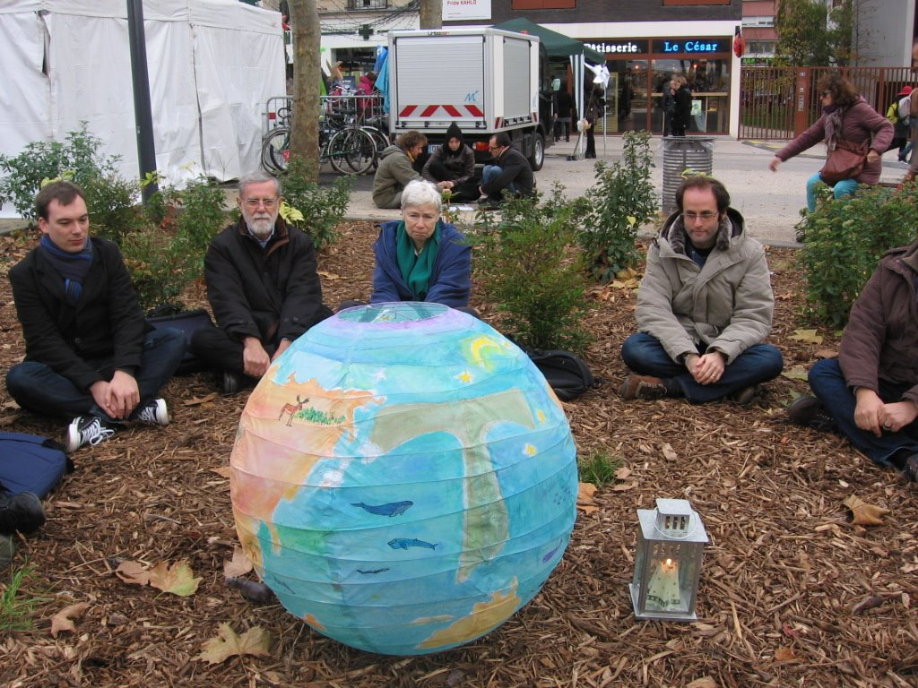

Slide 10
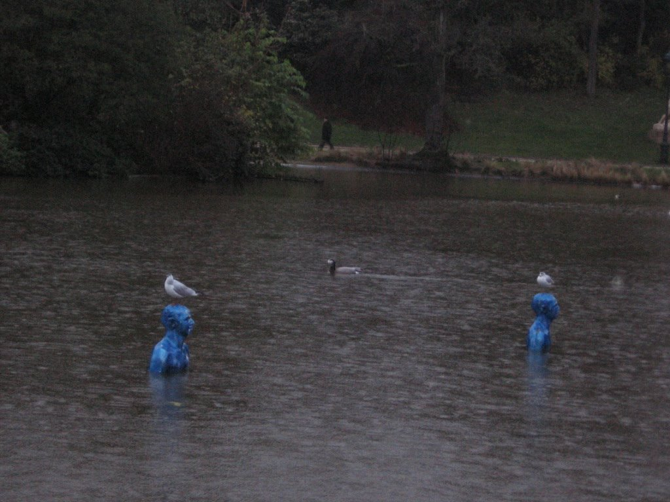
“Every year the problems are more grave. Politicians have done little to address the situation. We are at the limit. We are at the limit of a suicide, to say a strong word.
I am sure that almost all who are in Paris…have this awareness and want to do something.”
Pope Francis
Nov. 30, 2015

Slide 11
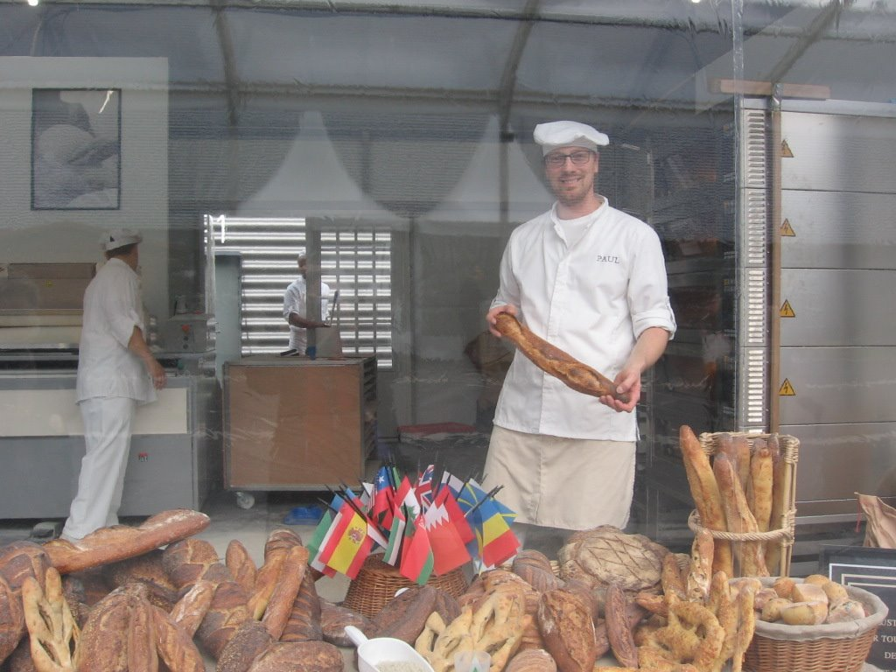
COP 21---A Historic Moment
A Sacred Bread Event

Slide 12
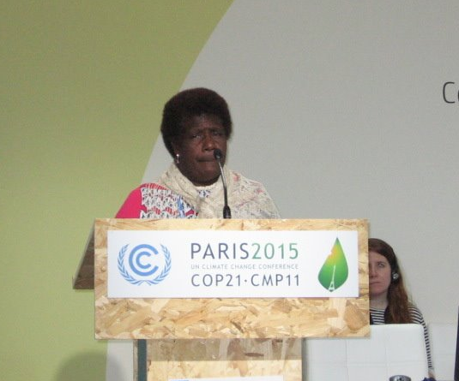
Cartaret Islanders made eye catching headlines:
“Going, going…Papua New Guinea Atoll sinking fast”.
“First environmental refugees”
Tired of empty promises the Carterets Council of Elders formed a non-profit in 2006 to relocate their 3,300 member island. Tulela Peisa, which means “sailing the waves on our own” became their new name.
Ursula Rakova was honored on Women’s Day at COP21 as a leader in her community facing the relocation of the first island nation due to climate change.

Slide 13
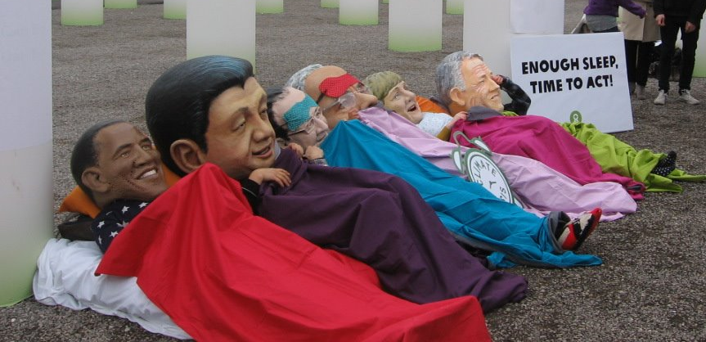
5 Most Important Components of Paris Climate Agreement
Temperature goal of “well below 2 degrees Celsius or 3.6 degrees Fahrenheit above preindustrial levels with an aspirational goal of 1.5 demanded by vulnerable nations--- “1.5 to stay alive”

Slide 14
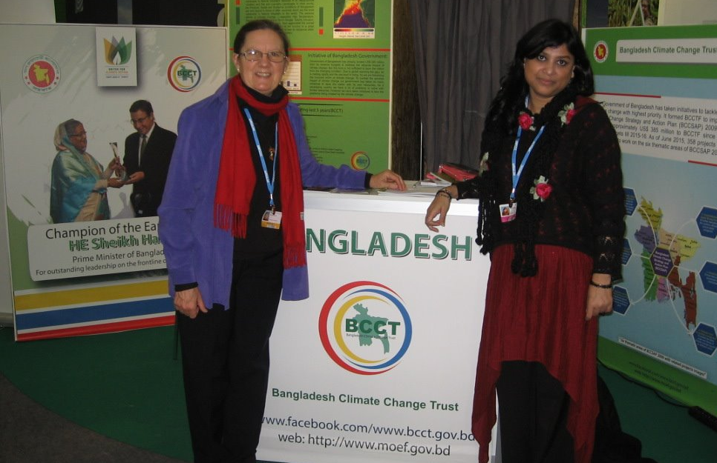
Ratchet mechanism to increase Intended Nationally Determined Commitments (INDC’s) from 195 nations. Interim review in 2018 before 2020 date for agreement to take effect with reviews and accountability every 5 years.

Slide 15
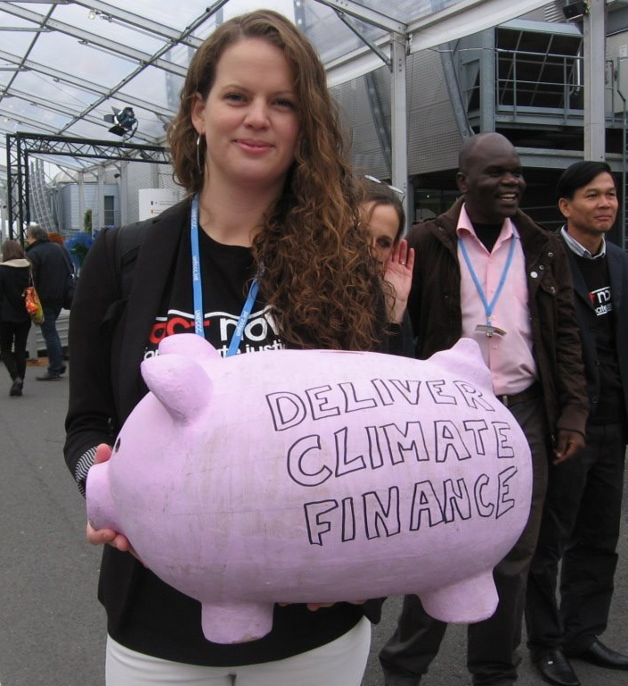
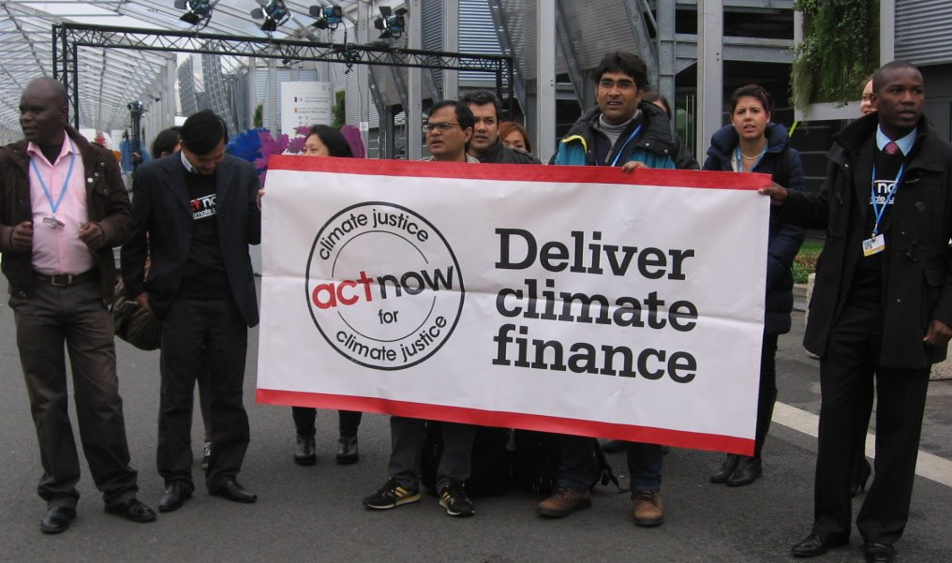
Financial assistance with a promise from developed countries to provide $100 billion per year in climate aid to developing nations and an increase every 5 years. Developing nations will also make a pledge.

Slide 16
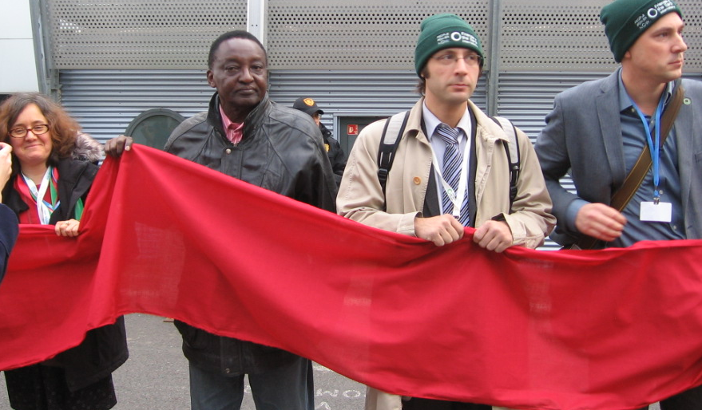
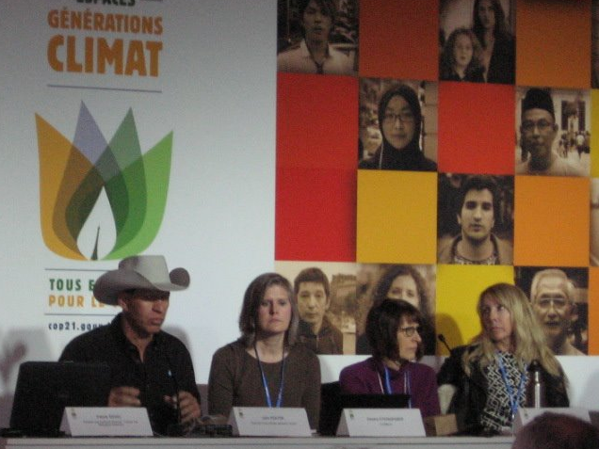
Fossil fuels are on their way out! Long term goal of the agreement sends strong signal to world capitals and financial markets that a massive scaling up of investments for clean energy is necessary with an aim for “global peaking of greenhouse gas emissions as soon as possible”. Transition must have equity and effort to eradicate poverty in the context of sustainable development.

Slide 17
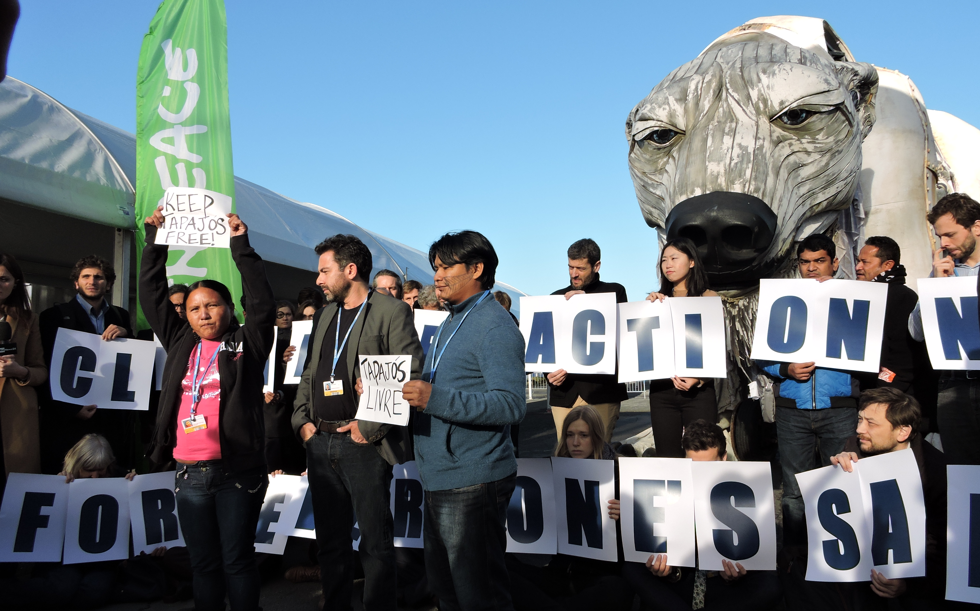
Loss and Damage: Industrialized nations that are responsible for most of the global warming compensate developing countries. No country will be legally bound; however, loss and damage is in the agreement in its own section allowing the issue as a matter of discussion and decision making in the future.

Slide 18
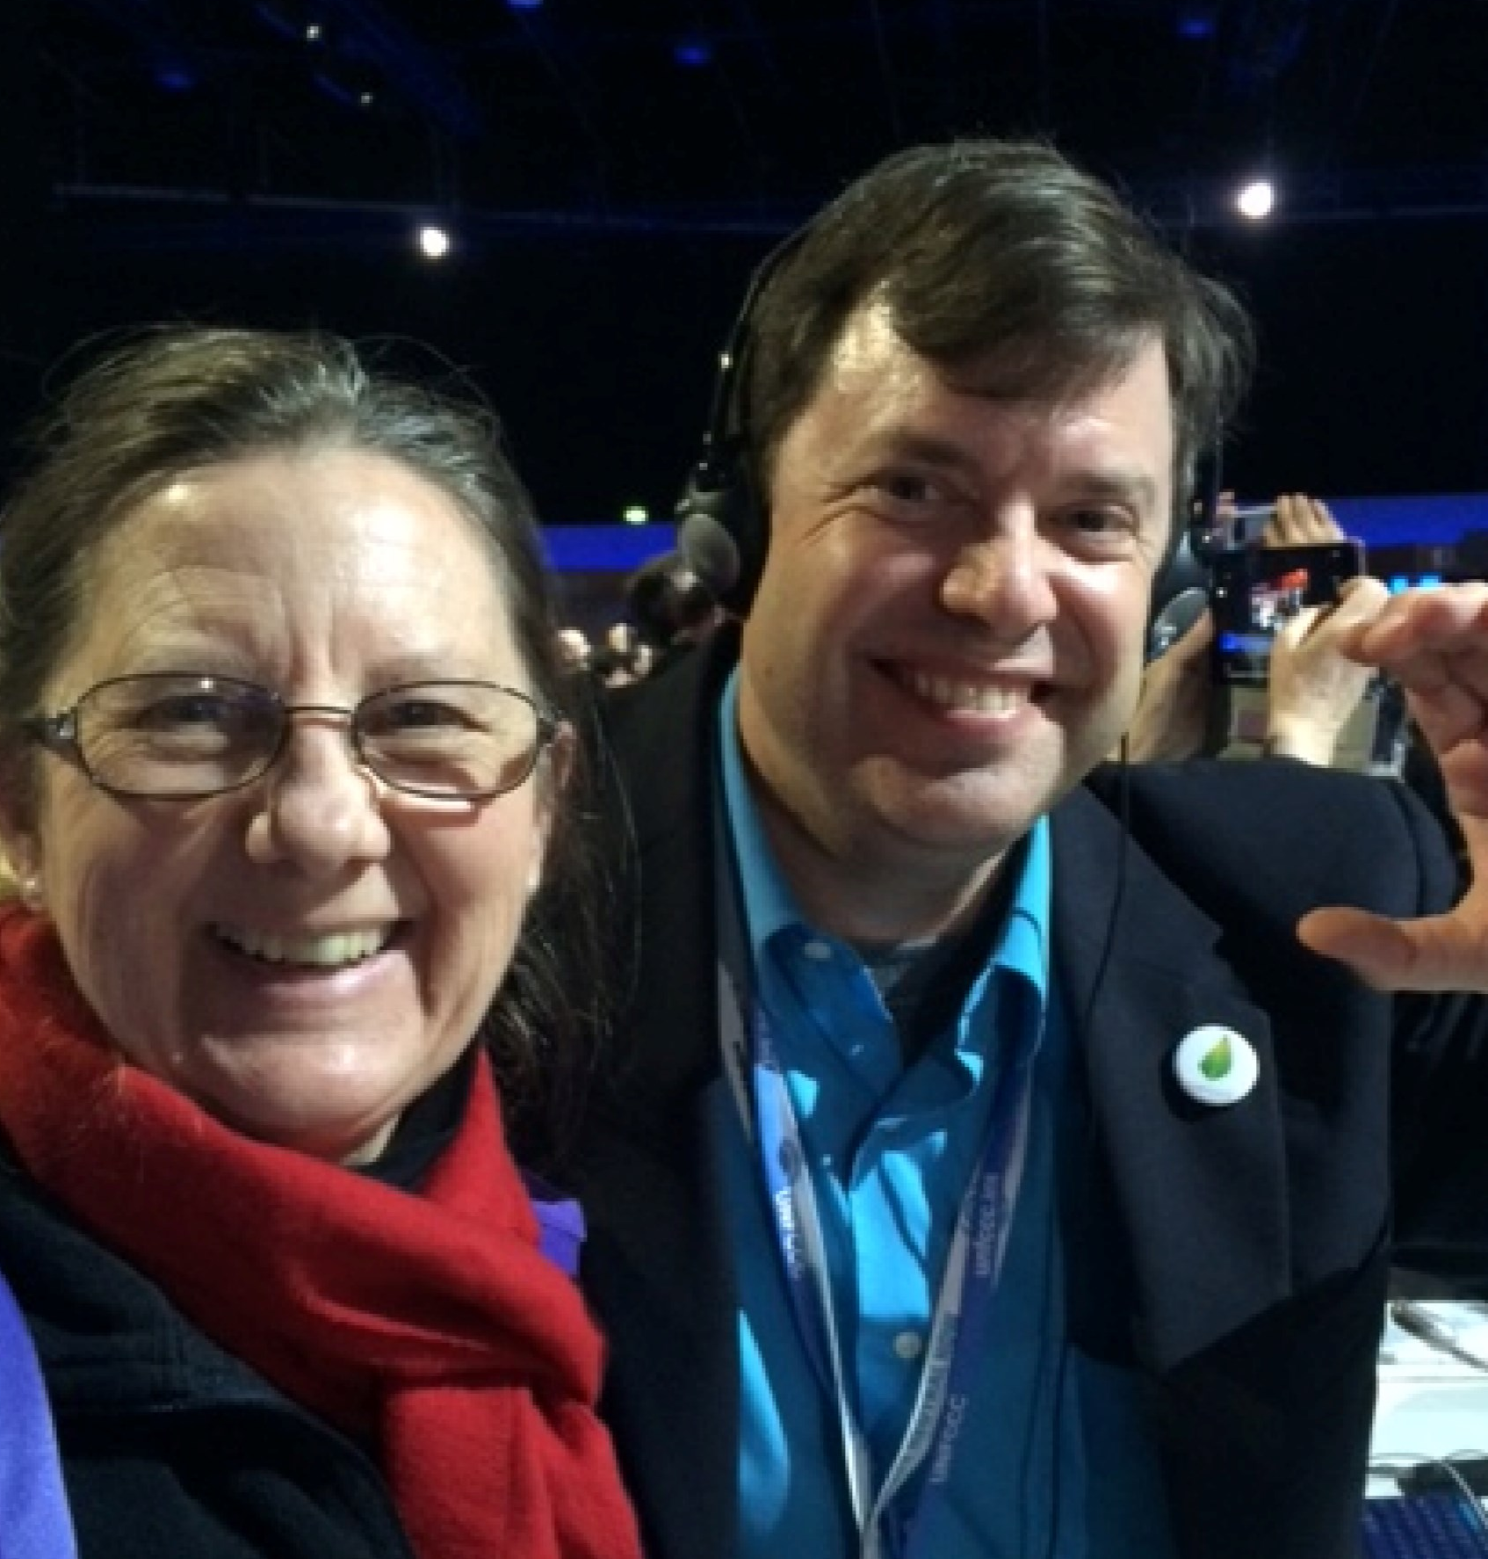
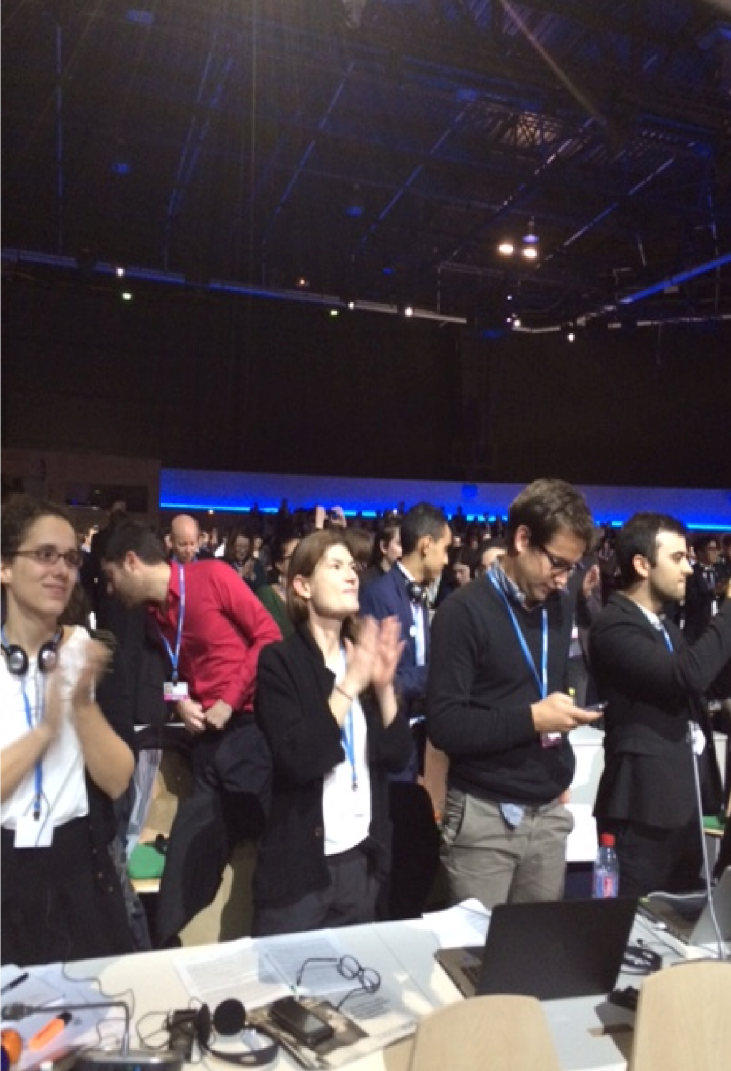
Reflections on COP21—After Celebrating

Slide 19
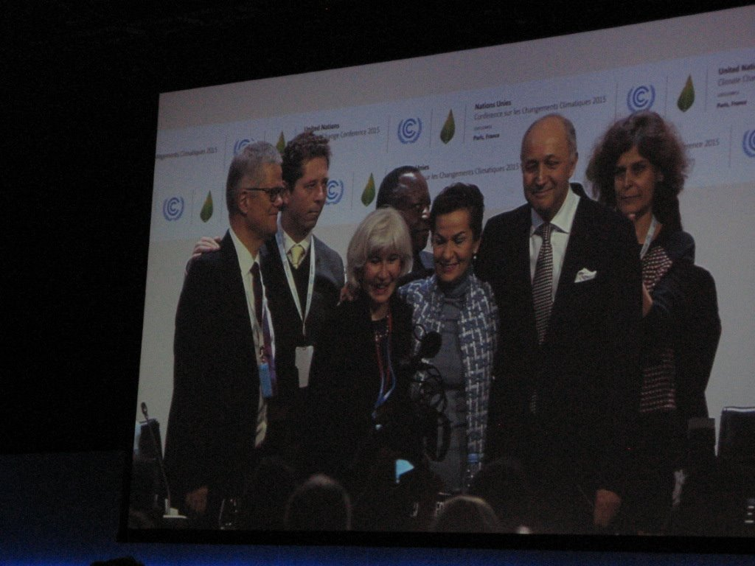

Slide 20
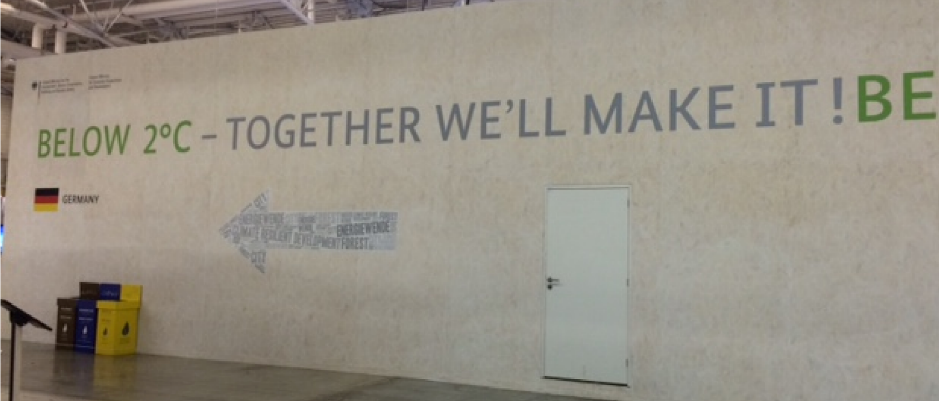
Hope, Courage, Dialogue
“I have walked that long road to freedom.
I have tried not to falter; I have made missteps along the way.
But I have discovered the secret that after climbing a great hill, one only finds that there are many more hills to climb.
I have taken a moment here to rest,
to steal a view of the glorious vista that surrounds me,
to look back on the distance I have come.
But I can only rest for a moment,
for with freedom come responsibilities,
and I dare not linger,
for my long walk is not ended.”
Nelson Mandela

Slide 21
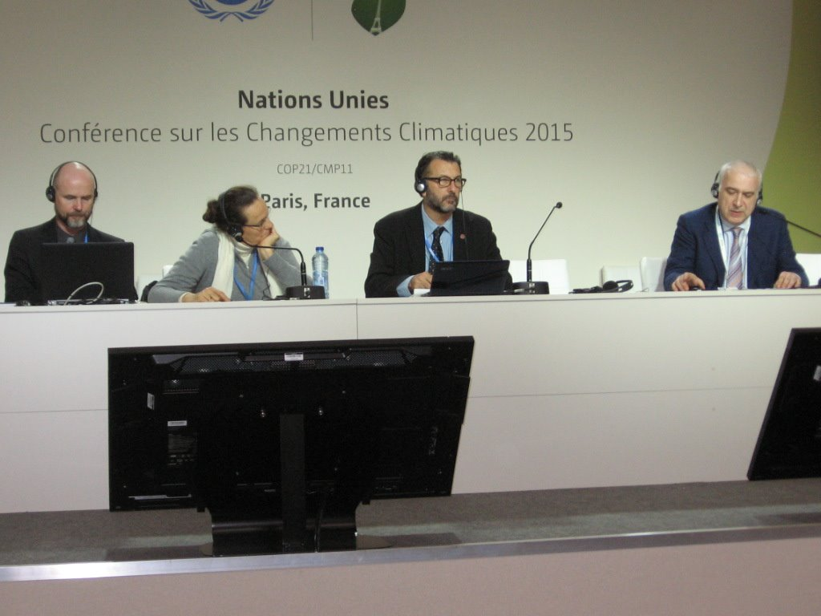
Faith Community and Civil Society voices and actions vital in putting forth ethical and moral imperative

Slide 22
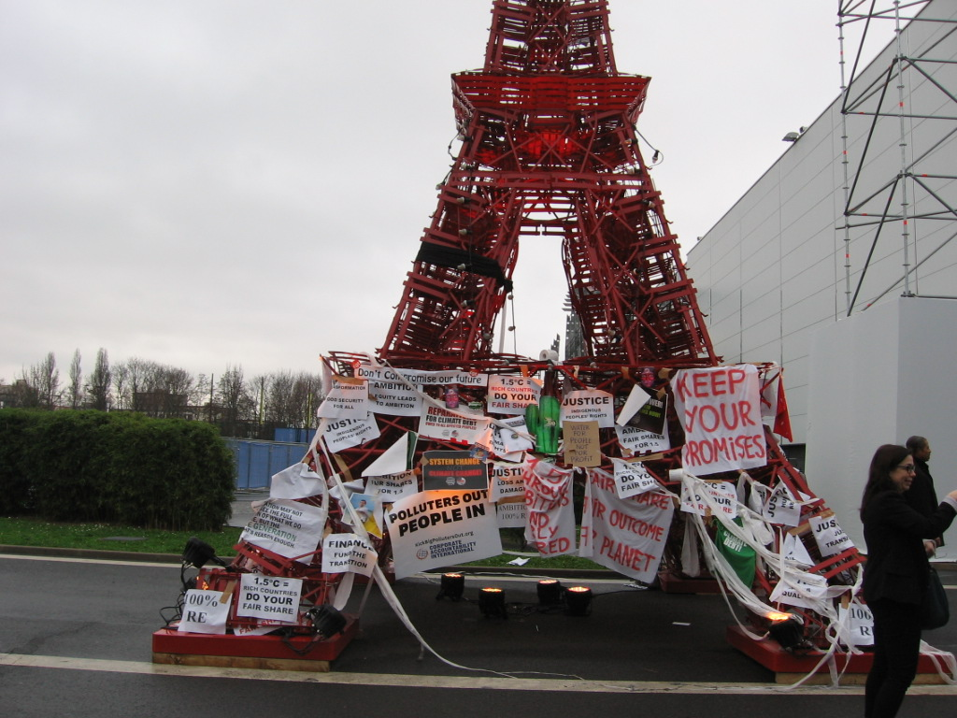
Civil Society and faith communities are needed to push for strong action and accountability in Policy advocacy and with civic leaders to act for the common good

Slide 23
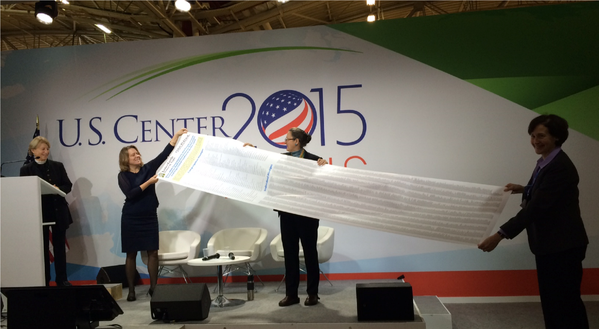
Individual and collective actions addressing carbon emissions important--- like Interfaith Power and Light Paris Pledge

Slide 24
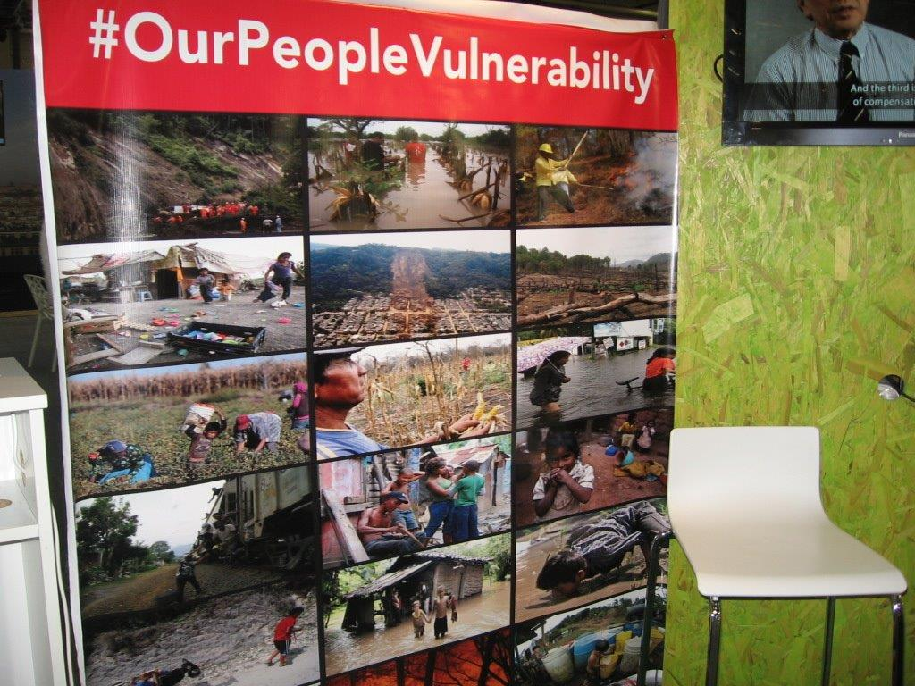
Connecting the dots with concerns such as water, food sovereignty, immigration, war, terrorism, and human trafficking is vital. We are all one and increasingly all concerns are related to climate change.

Slide 25
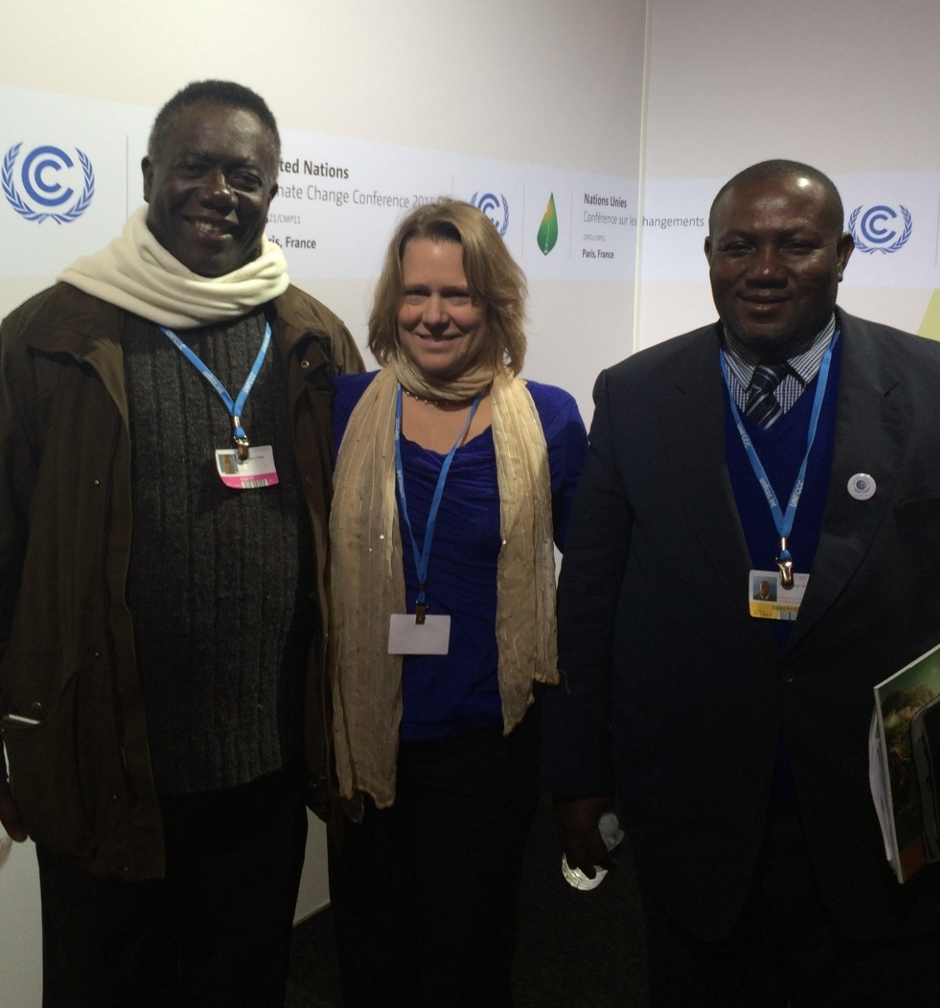
Solidarity work like the Carbon Covenant and Chico Mendes Projects addressing adaptation and mitigation

Slide 26
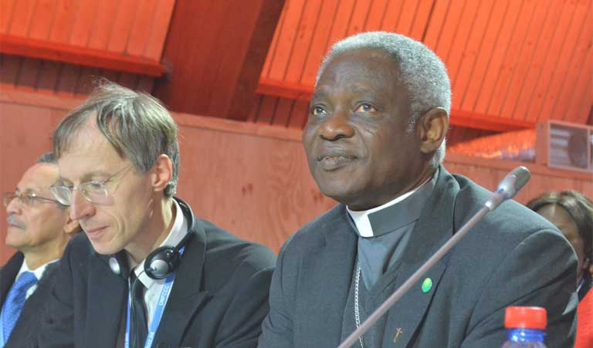
A Choice to be an active voice of Love In the context of a reality check
*Paris Climate Agreement is historic with 195 nations committing.
*Foundational stepping stone and not the answer.
*Incredible work and action is needed because:
*Green House Gas emissions will continue to rise and are
at 400 ppm, above 350ppm climate scientists say is safe
*Prof. Hans Schellnhuber, Potsdam Institute for Climate Impact Research notes:
*2 degree target means CO2 out of system by 2070
*1.5 degrees—eliminate CO2 emissions by 2050
* Johan Rockstrom, Stockholm Resilience Center says to reach 1.5 degrees, richest nations need to reach zero fossil fuel use by 2030.
Cardinal Peter Turkson of Ghana, head of the Pontifical Council on Justice and Peace at a COP21 press conference in Paris.
“Humanity is one family. As brothers and sisters, we have only one common home. The earth was given to us as a garden. Let’s not make it uninhabitable for the children who come after us.”

Slide 27
Public Policy Advocacy
  Sign Paris Pledge for individuals and/or faith communities
  Contact Secretary of the EPA Gina McCarthy to lend support for the EPA rules addressing methane pollution and ask for stronger guidelines that include existing oil and gas wells
  Contact the Bureau of Land Management to express support for the rule making that is in comment period to address methane pollution from old and new oil and gas production
  Support Clean Power Plan implementation from EPA that addresses coal fired power plant emissions that contribute to climate change
  Learn about and share your concerns about the TPP Trade Agreement with your congressional leaders
  Work with state and local initiatives that address climate change and energy through legislation, building codes and elected officials that advocate strong action
  Green Climate Fund at the federal level for ongoing funding to assist with adaptation to climate change for most vulnerable brothers and sisters around the planet

